Slide 1
I Can Handle Embarrassment
Notes:
Introduce the topic of embarrassment to the students. Ask for their definitions of the word.

Slide 2
We all get embarrassed sometimes…
We might say or do something that makes us look silly in front of other people
Notes:
Read slide with students. Talk about how everyone has been embarrassed by something they have said or done. Ask students to share examples. Start things off with your own example if necessary.

Slide 3
What might happen to your body when you’re embarrassed?
blush
sweat
heart races
Notes:
Read slide with students. Ask for their input, then click to bring up each picture. Talk about the effects of embarrassment on our bodies. (we might blush, sweat, our heart races, etc.)

Slide 4
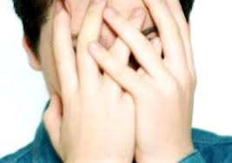
How does it make you feel?
self-conscious
ashamed
like I want to hide
Notes:
Read slide with students. Talk about how it might feel like everyone is looking at us. All those eyes might make us feel self-conscious, ashamed, like we want to hide. When we feel that way, it’s hard to figure out what to do.

Slide 5
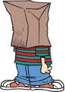
What can we do when we’re embarrassed?
no – not that!
Notes:
Read slide with students. Say that while we’d like to just hide away until the embarrassment passes, that’s not realistic. Ask for their ideas about what to do instead. List these on the board.

Slide 6
4 Ways to Handle Embarrassment
Stop beating yourself up
adapted from www.wikihow.com
Notes:
Read slide with students. Talk about how important it is to forgive yourself. We’re only human – we’ll make mistakes and do other silly things. It’s hard to forgive ourselves if we keep going over and over the embarrassment in our minds. In order for us to move past these embarrassing moments, we need to stop beating ourselves up and forgive ourselves.

Slide 7
Laugh at yourself
adapted from www.pbskids.org
Notes:
Read slide with students. When we’re able to laugh at ourselves, it helps us to move past the embarrassing incident and get on with our lives. We’re so busy laughing that we don’t stay embarrassed for too long. (adapted from www.pbskids.org)

Slide 8
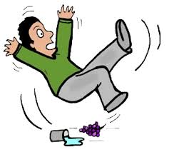
Change the subject
Anybody watch Ninja Warriors last night?
I can’t believe I just fell in front of everyone…
adapted from www.wikihow.com
Notes:
Read slide with students. Talk about how changing the subject helps you and your friends move past those embarrassing moments. Ask students for examples of how they could change the subject if they found themselves in an embarrassing situation.

Slide 9
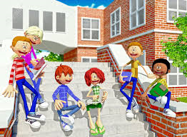
Move forward
Yeah – I’m pretty clumsy. Anybody want to go to McDonald’s?
adapted from www.pbskids.org
Notes:
Read slide with students. Talk about how owning the embarrassing moment quickly, then moving forward with a suggestion can help everyone get past the incident – especially you! Dwelling on the embarrassment can make it worse!!

Slide 10
Remember: 4 Ways to Handle Embarrassment
Stop beating yourself up
Laugh at yourself
Change the subject
Move forward
Way to go!!
Notes:
Read slide with students. Review the 4 Ways to Handle Embarrassment.

Slide 11
So…what do YOU think?
You’re sitting in the cafeteria after lunch when suddenly your friend burps – really loudly!! Everyone stops talking and looks at her. Your friend is so embarrassed!
What can you do?
Notes:
Read slide with students. Ask if they remember the 4 ways to handle embarrassment. Ask how they might be able to help their friend by using these strategies.

