Slide 1
Making Good Choices at School
Notes:
Read slide with students to introduce topic of today’s lesson: Making Good Choices at School

Slide 2
What does “make a good choice” mean?
to do the right thing
to follow directions and school rules
to make sure we’re not hurting anyone (or ourselves)
Notes:
Read heading of slide with students. Talk about how sometimes parents and teachers might tell us to “make a good choice”, but what does that mean? Get students’ input and list their ideas on whiteboard. Now click to bring up some descriptors on slide Discuss each in more detail, using students’ input.

Slide 3
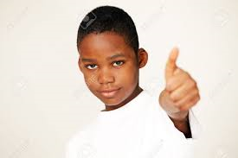
Making a good choice means we have to be in control of ourselves!
our _{words}
_{our thoughts}
our _{actions}
Notes:
Read slide with students. Talk about how making good choices depends on our ability to control our thoughts, words, and actions.

Slide 4
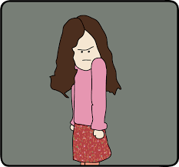
Sometimes it can be hard to make a good choice…
_{I’m}
mad!!
The ‘mad’ gets in the way of making good choices
Notes:
Read slide with students. Talk about how it’s hard to make a good choice when we’re mad because sometimes we’re not able to control our thoughts, words and actions when we feel this way. The ‘mad’ gets in the way of our making good choices.

Slide 5
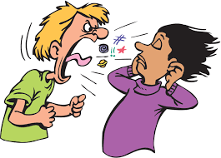
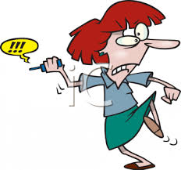
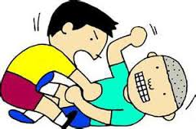
Sometimes when we get mad, we might…
Notes:
Read slide with students. Click to bring up pictures one at a time. Ask students to tell what is happening in each picture [1. yelling; 2. throwing; 3. fighting] Talk about how being mad can lead to these behaviors and get in the way of making good choices.

Slide 6
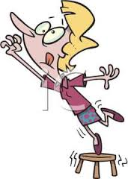
Sometimes we might want something so much…
The ‘want’ gets in the way of making good choices
Notes:
Read slide with students. Click to animate picture. Ask students to tell what is happening in the picture and what might be about to happen. Talk about how wanting something so much can get in the way of making good choices.

Slide 7
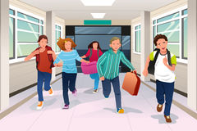
Sometimes we see other kids doing something so we do it too…
Notes:
Read slide with students. Ask students what is happening in the picture (running in the hall). Talk about how seeing other kids do something might make us want to join in – even if it is against the school rules. Ask students what they’re supposed to do in the school hallways (walk) and why that is a rule at school (to keep everyone safe; so no one falls/gets hurt; etc.)

Slide 8
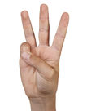
It’s easy to make good choices at school if we remember 3 things:
Be Kind
Be Safe
Be Responsible
Notes:
Read slide with students. Explain that they will learn 3 ways to help them make good choices at school.

Slide 9
Be Kind
helpful – not hurtful
nice words and actions
_{Hi!}
_{How’s it going?}
Notes:
Read slide with students. Ask for examples of helpful vs. hurtful words and actions (EXAMPLES OF WORDS: greetings, please and thankyou, excuse me, compliments, ETC.; EXAMPLES OF ACTIONS: helping a classmate pick up something he dropped, holding the door for someone, letting someone go first, sharing something, etc.) Summarize this slide by relating these points to making good choices.

Slide 10
Be Safe
walk in the hall
keep hands and feet to yourself
stay in your own space
Notes:
Read slide with students. Talk about how each point on slide keeps us safe. Talk about what might happen if we don’t do these things that keep us safe. You can even help students visualize a bubble around them that will help them to stay out of others’ personal space. Emphasize that when we do these things, we’re making good choices at school.

Slide 11
Be Responsible
“own your mistakes”
be accountable for your actions
Notes:
Read slide with students. Talk about what “owning your mistakes” & “being accountable” means (i.e. accepting responsibility for doing something wrong and then trying to fix it.) Reassure students that we all make mistakes but that it’s important to take responsibility for them and to try to fix them. Ask for examples of times the students might have made a mistake and how they took responsibility for it. Offer your own examples too. Again, tie the examples in to making good choices at school.

Slide 12
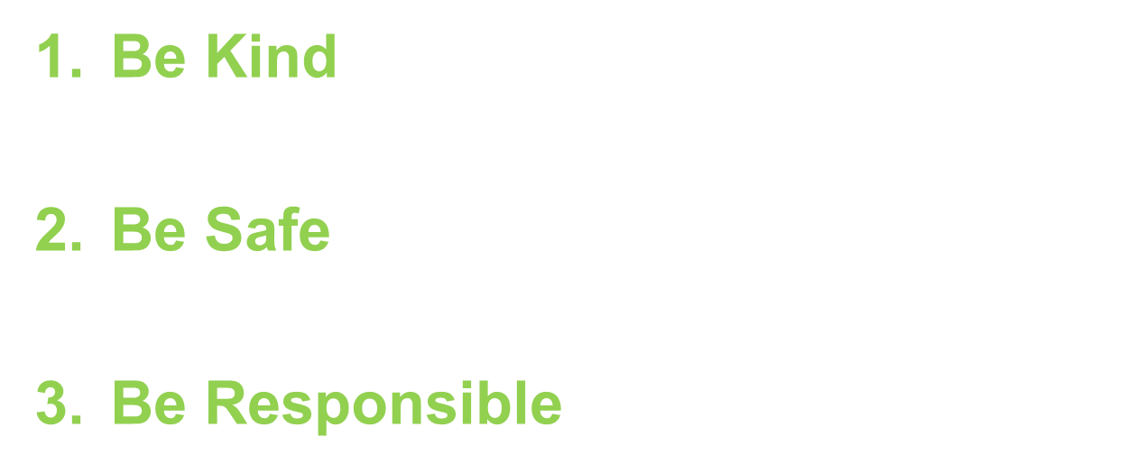
Remember, to make good choices at school:
Notes:
Read slide with students to summarize the 3 points to remember to make good choices at school.

Slide 13
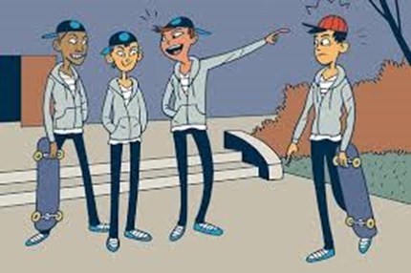
So…what do YOU think?
Your friends are talking about how fun it is to skateboard down the slide on the playground after school. They want you to go too! What can you do?
Notes:
Read slide with students. Talk about the situation and ask students to list the 3 points about making good choices (BE KIND, BE SAFE, BE RESPONSIBLE), If they choose to go along with their friends, are they forgetting any of these things that might keep them from making a good choice? Ask what might happen if the do use their skateboard on a slide (they could get hurt, they could damage school property and get in trouble, they might lose privileges at home, etc.)

